Slide 1


Cloud Permit
Lac du Bonnet’s New Digital
Online Permitting Format

Slide 2
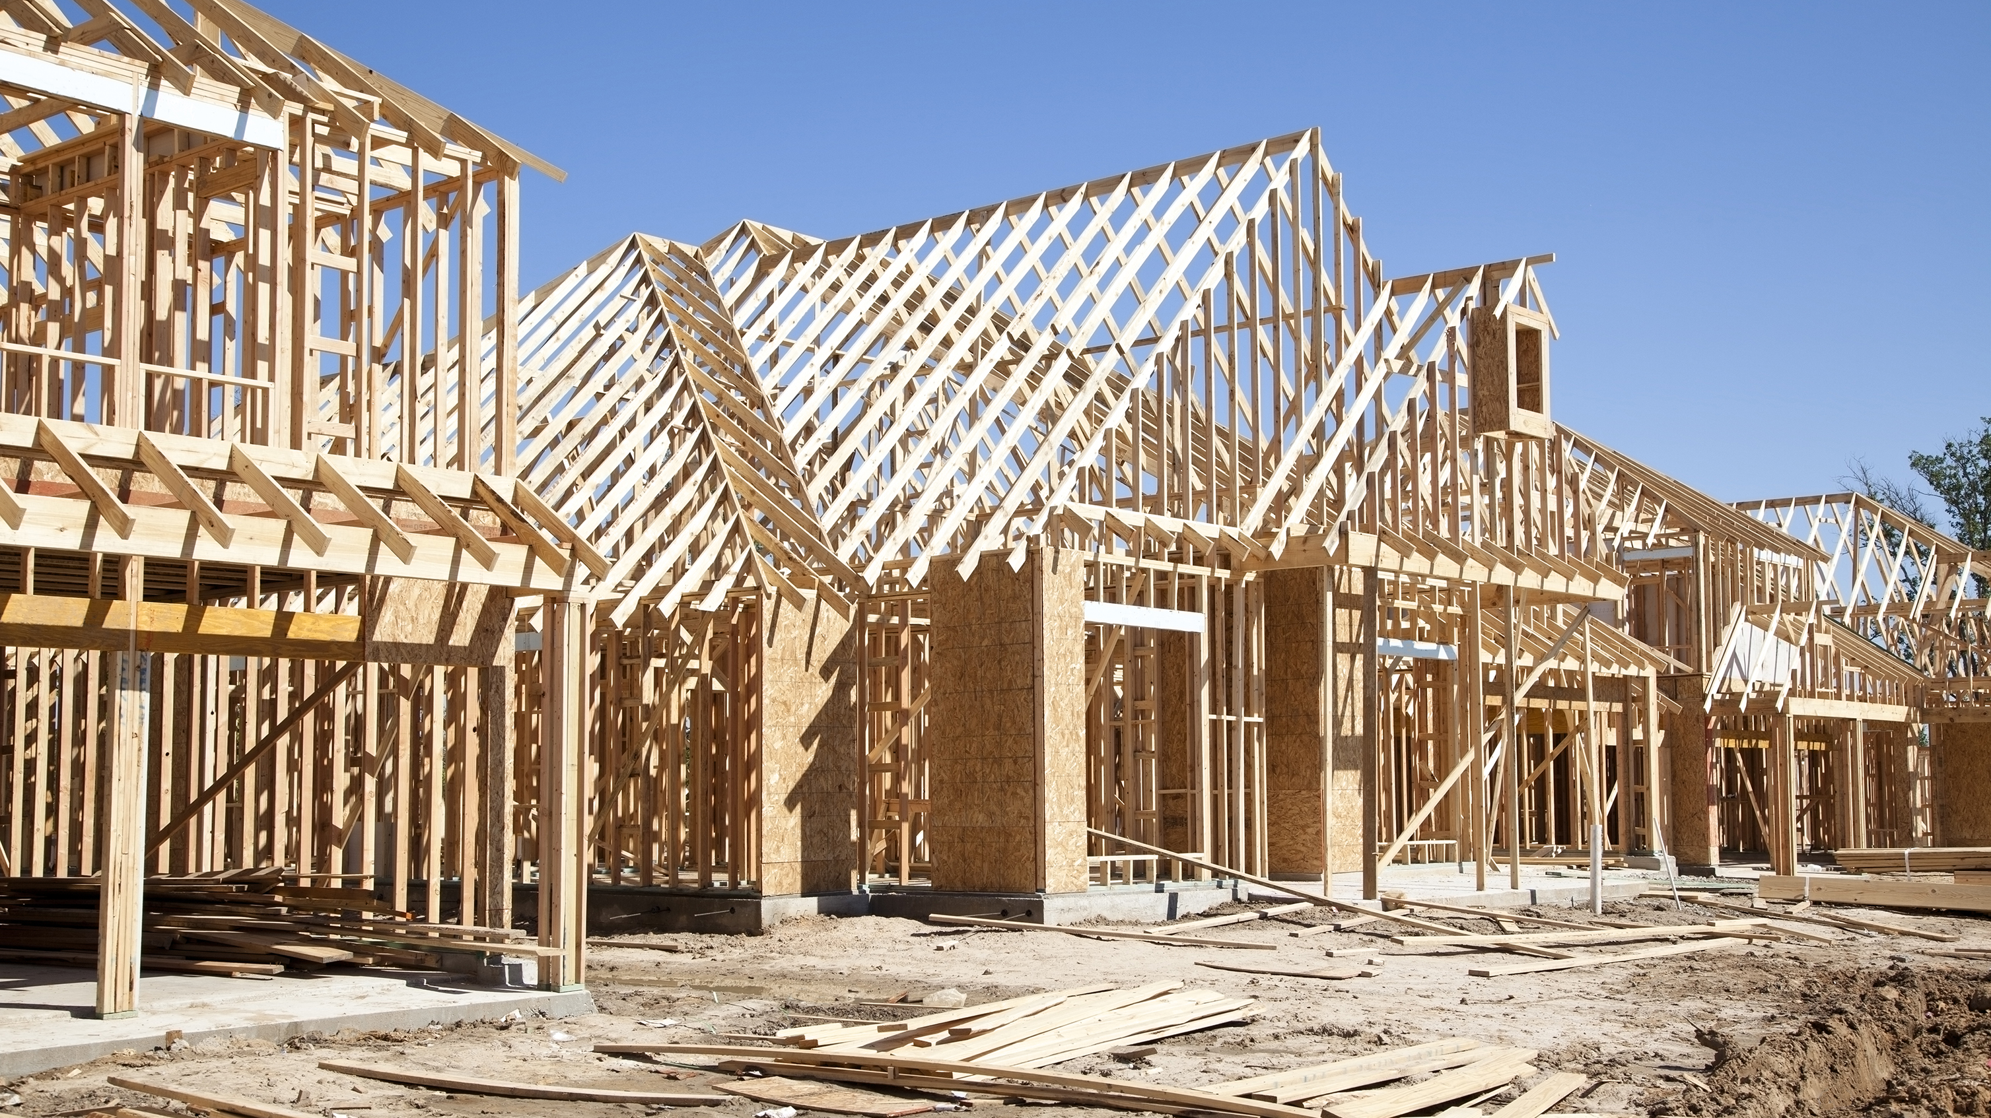
Welcome to Cloud Permit!!
Lac du Bonnet has made a giant step in technology when it comes to their building permit process. Keep checking our website for updates on the permitting process, requirements, and even some handy tips to help you along with your building process. Whether you are starting to build a simple storage shed or multi-unit complex, we are here to help.
Cloud Permit makes it simple to apply for permits from the comfort of your own home. This power-point will guide you through the process step by step. Cloud Permit allows us to serve you better! E-mail updates at every stage of your permit application. Keeping you up to date with what inspections are required and what the outcomes of those inspections are. We also do all of the Fees management for permitting through Cloud Permit.
Cloud Permit is a tool that we will use to serve the community better, have better communication, and help make your build run as smooth as possible on our end.
Thanks for your time, so let’s begin.
Mike Tomasson, Building Inspector

Slide 3
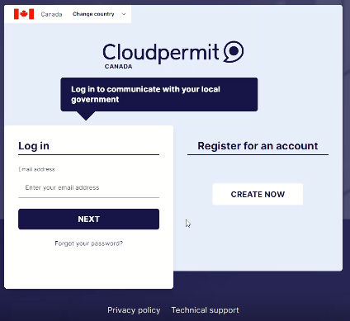
You will need your email to create an account in Cloud Permit.
Go to the Cloud Permit link on our website or type in Cloud Permit Canada to create your account.
Just follow the few simple steps and check your email!
Push the create now button if you are a new user

Slide 4
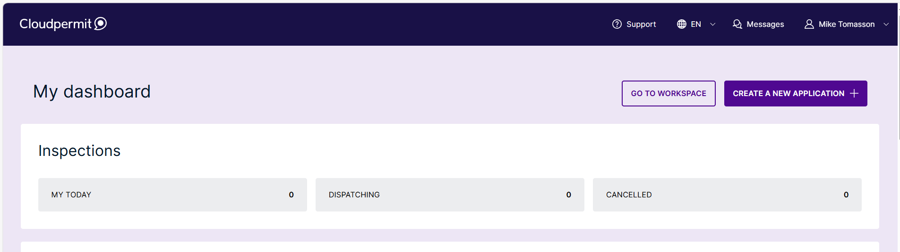
Once you have created an account, this is what your workspace will look like.
Click here to apply for a new permit

Slide 5
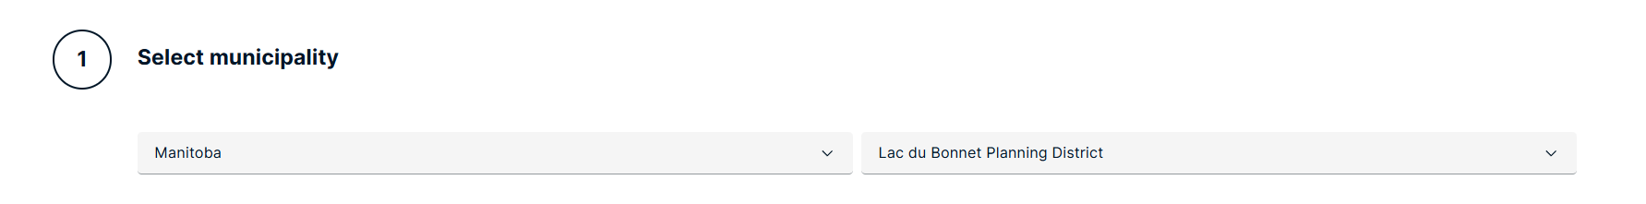
Fill out the Province and Location of where you are wanting to apply for the permit
Click here to apply for a new permit

Slide 6
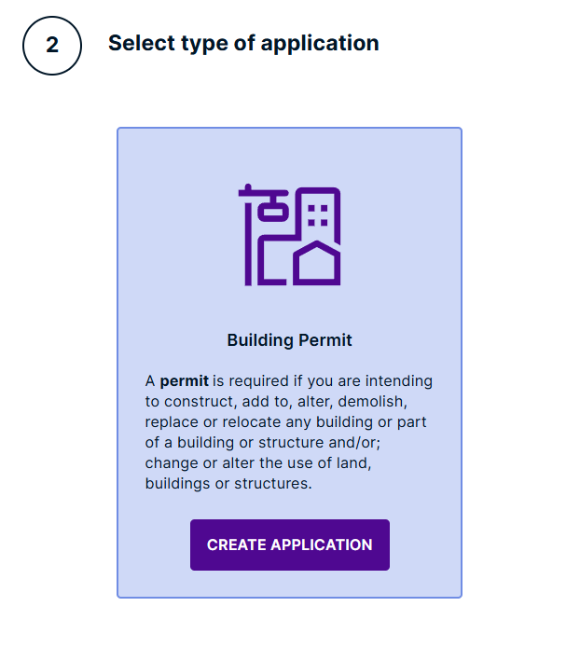
Select Building Permit

Slide 7
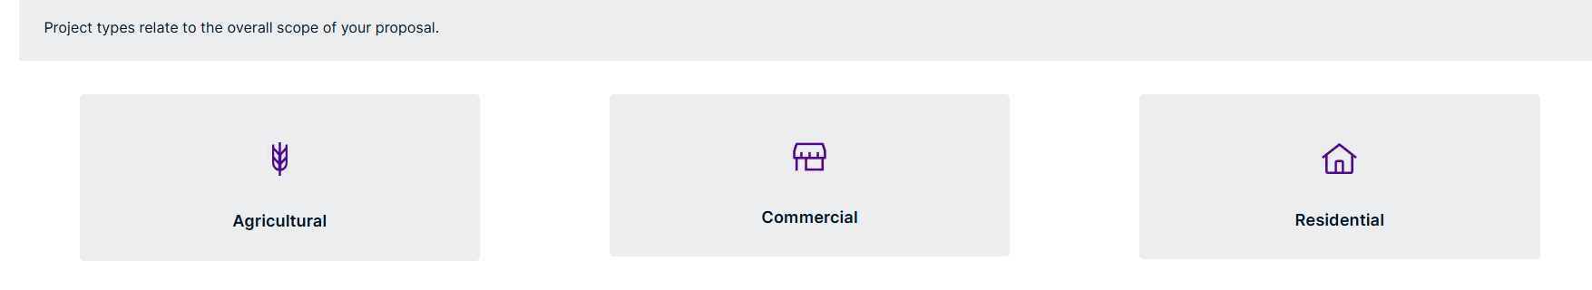
Select one of the three options below
(For Training Purposes, we will be selecting Residential)

Slide 8
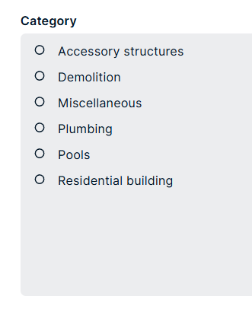
Then select the Category

Slide 9
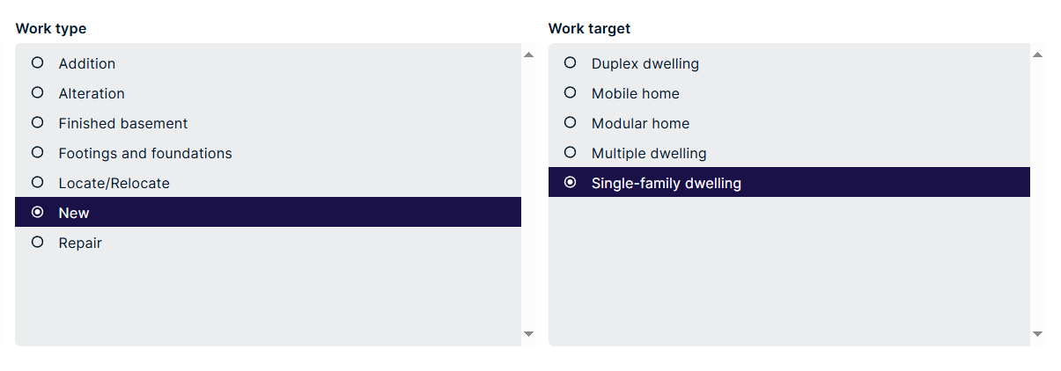
Select your work type (Renovation or New Build?)
Select your work target (Single-Family or other)

Slide 10
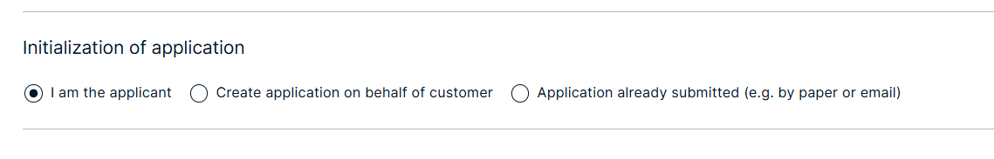
For this Training you will be the applicant and the property owner.
Should you NOT be the property owner, you can continue although a confirmation email will be required to be sent and there would be a “Sign Off” necessary to provide permission from the Property Owner that you have consent to act on their behalf.
You enter the email address of the property owner and Cloud Permit will do the rest!

Slide 11
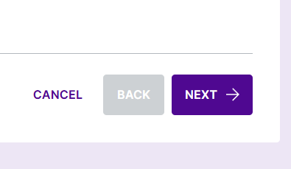
Always Remember to click the Next Button to proceed.

Slide 12
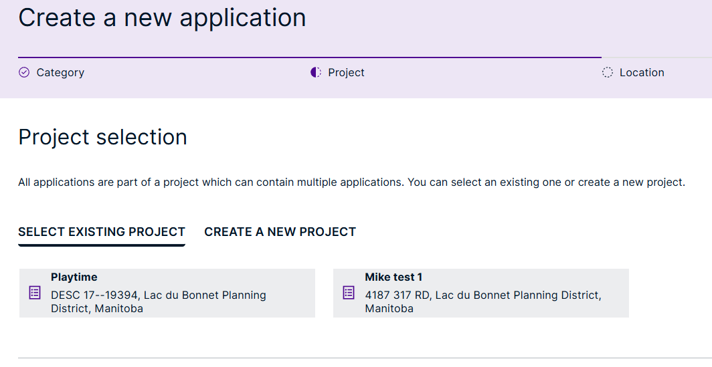
You now can choose if this is an existing project or a New Project. For this Training we are creating a New Project

Slide 13
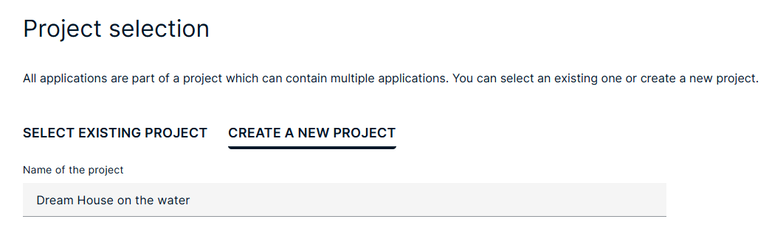
Now you get to name your project. Be as simple or creative as you like!!!

Slide 14
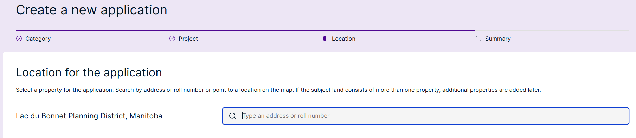
Start to fill in your location of this project and the system will probably help!

Slide 15
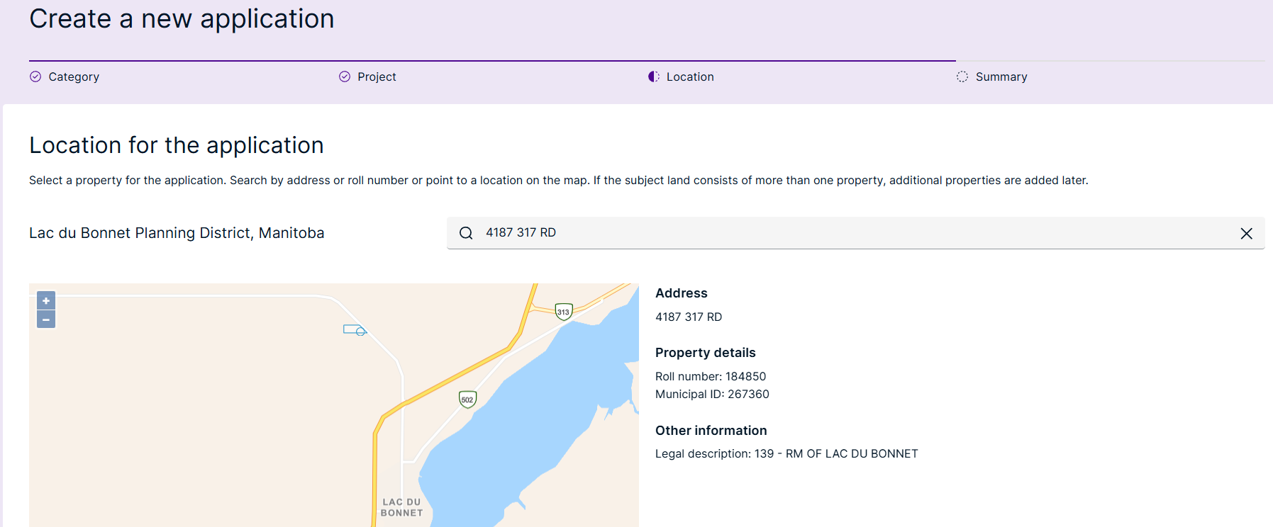
This address is our RM Building. For Training only

Slide 16
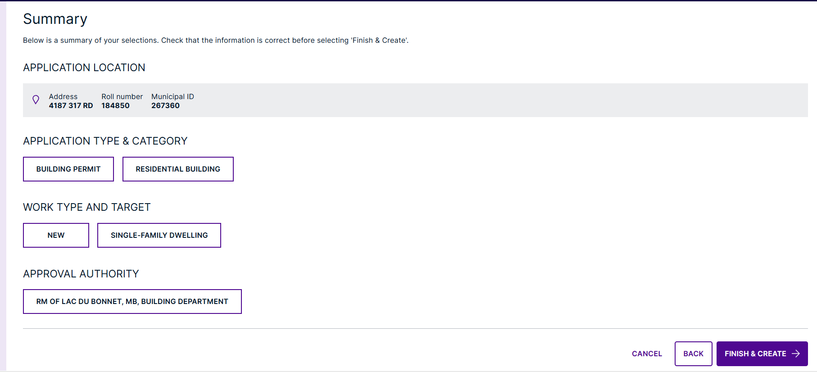
This step is just a summary. Check it over, when you are satisfied, click the “Finish and Create” button down below.
If you want to change something, hit the back button!

Slide 17
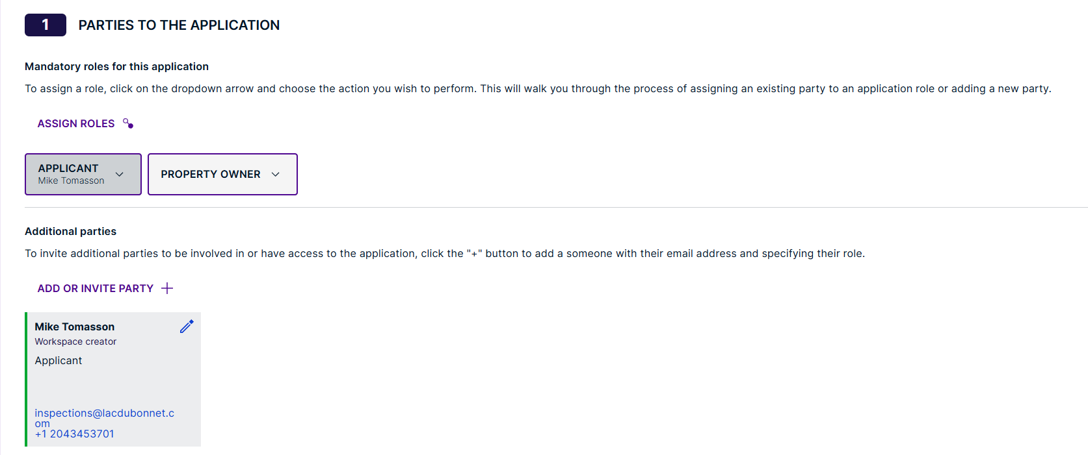
Here we are needing you to assign your roles. You can assign yourself as applicant and owner. You can also add site supervisors, builders, engineers, etc and whoever you want to be included in your building project. For example, if you have a framer that you need to keep updated on the process of the build, you can invite them, they will receive an email to accept the invite, once they accept it, they will get all notifications about the project.
IMPORTANT… All your invites will have access to your project for scheduling inspections, inspection reports, and files! Please be mindful of that when inviting!
You can limit access or remove them if you change your mind or change contractors etc.
Must assign property owner and applicant

Slide 18
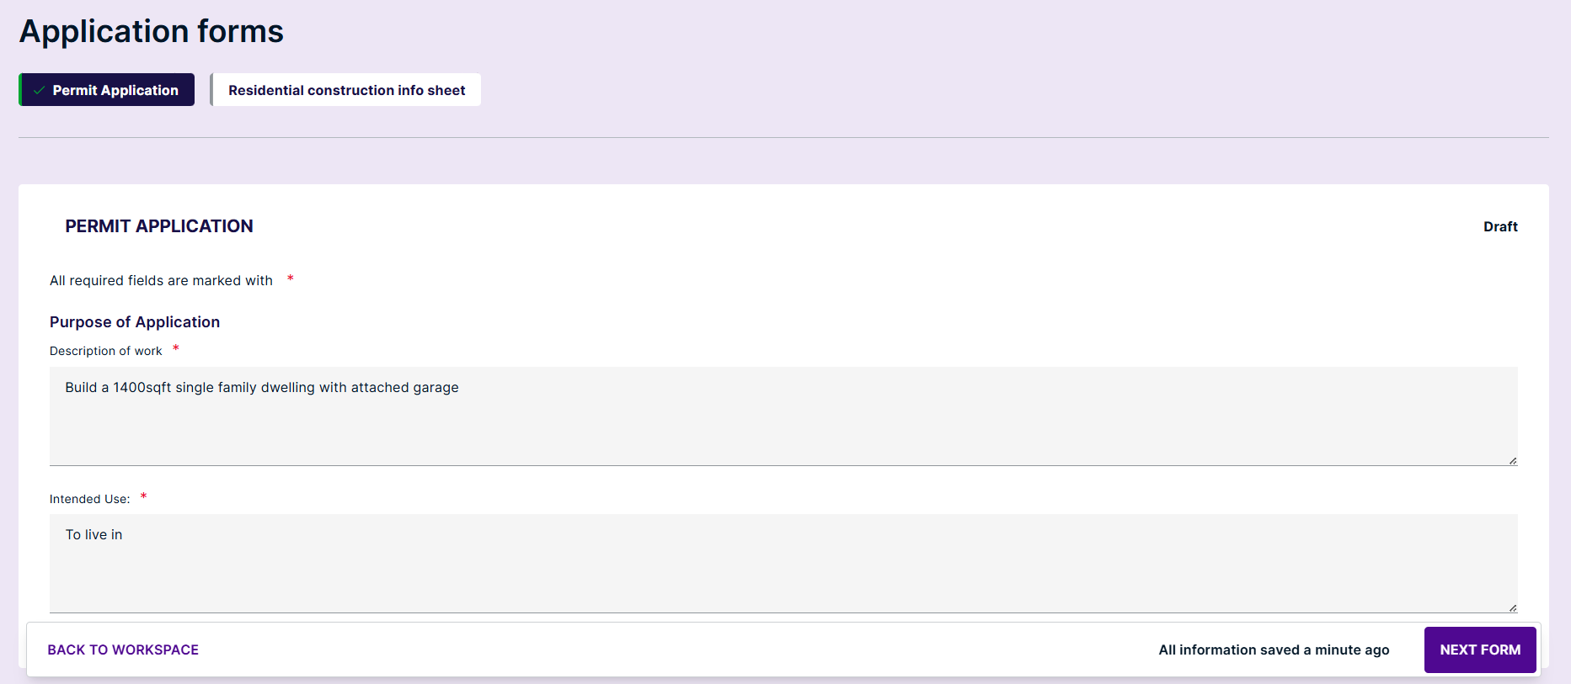
Under Application Forms there are a few simple questions to fill out, then click “NEXT FORM”

Slide 19
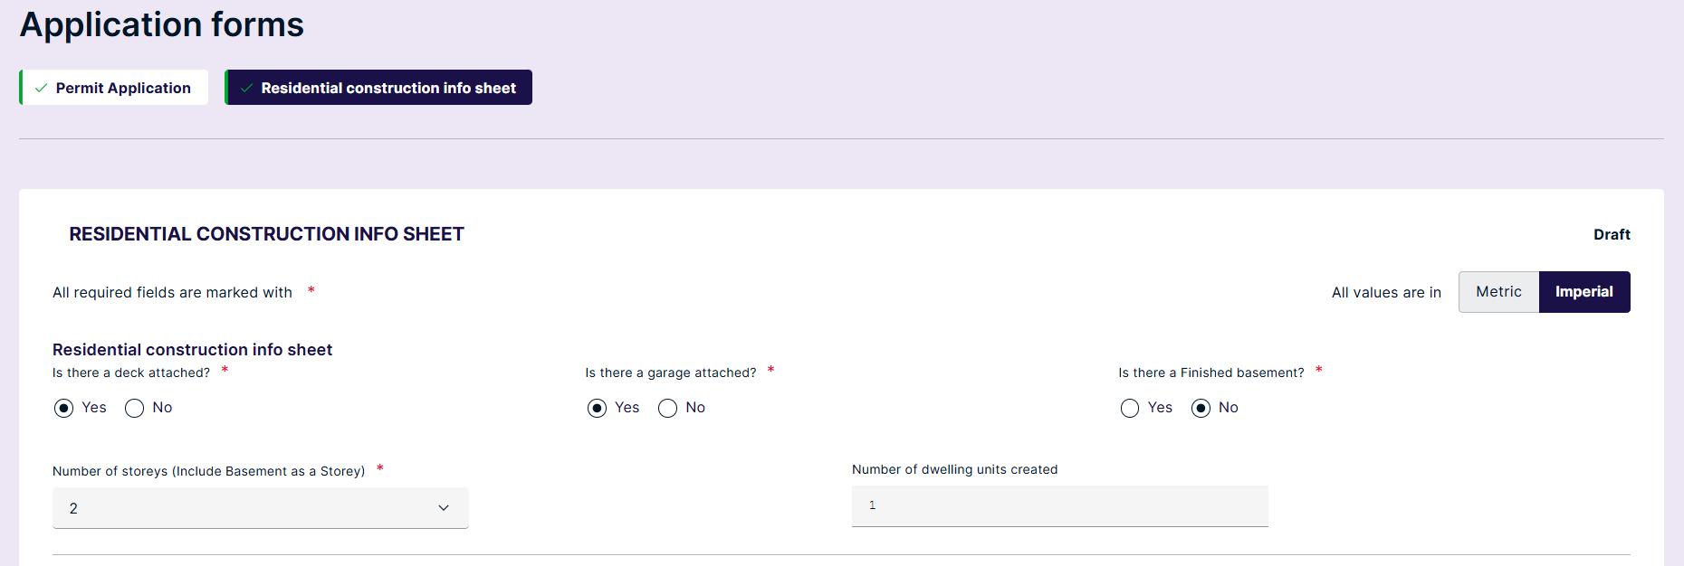
Again, Residential Construction, there are a few simple questions to fill out, then click CLOSE FORMS AND GO TO WORKPLACE
HINT: you can pick between Square Feet and Square Meters!!!

Slide 20
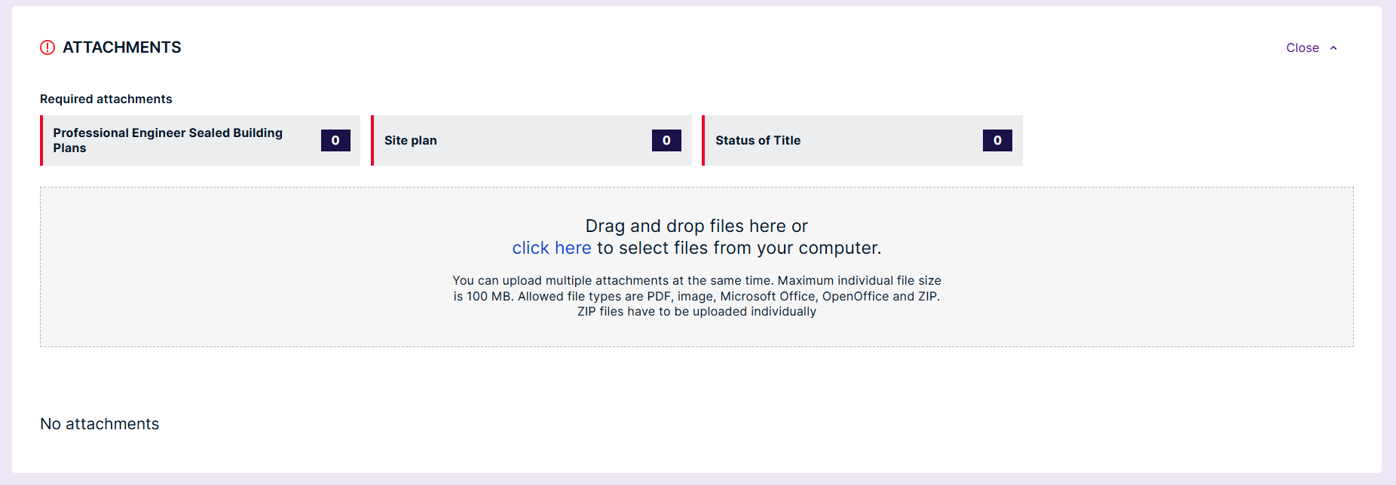
Check out the lines in RED, this means that the required documents have yet to be downloaded.
You can drag and drop your files and then assign a Type as to what the file is for. (For example, your stamped house plans would be your Professional Engineer Sealed Building Plans)

Slide 21
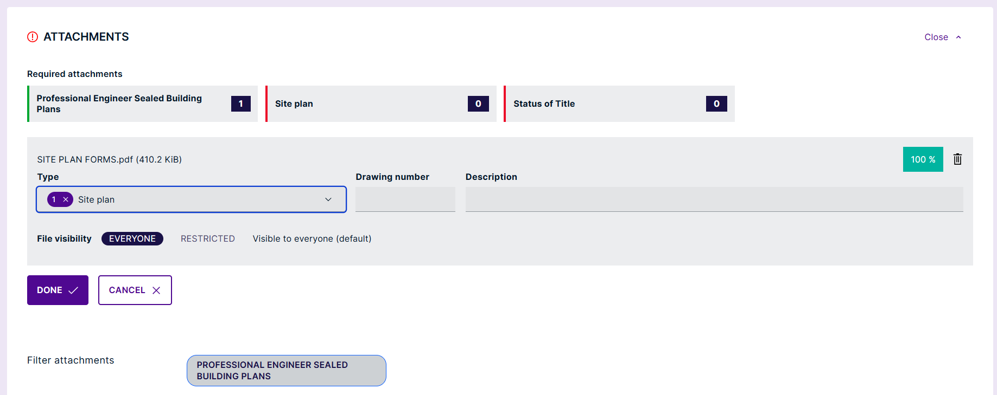
See how the Bar turned Green when file uploaded!
When site plan is assigned, click on Done, then the Bar in front of the Site Plan Tab will turn Green

Slide 22
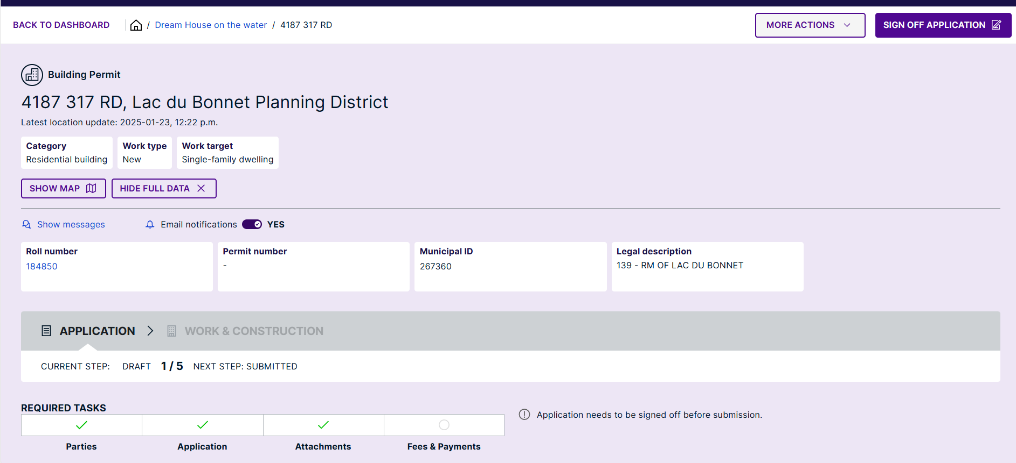
You are almost there!!! Click the
SIGN OFF APPLICATION button.

Slide 23
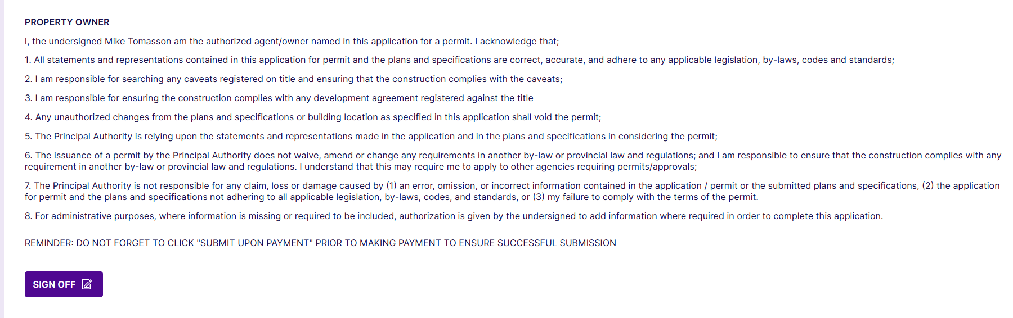
Officially sign off for the applicant and Property Owner.

Slide 24
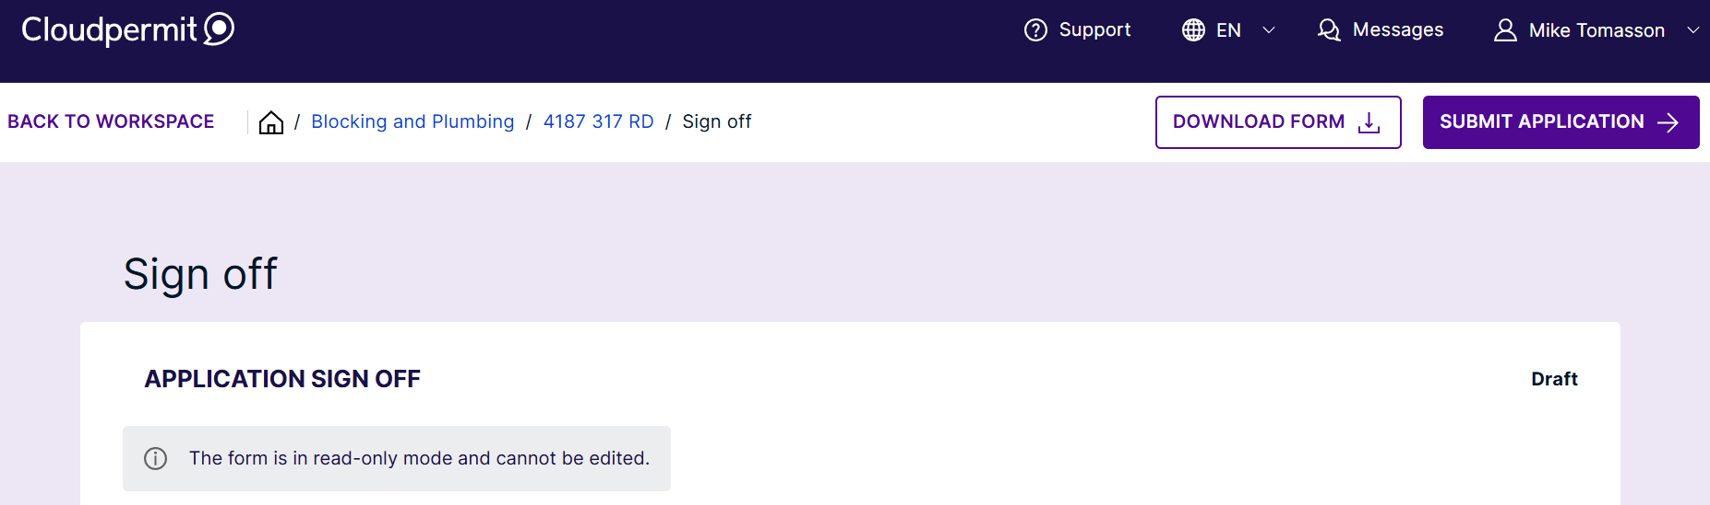
Don’t forget to SUBMIT the application.
Check your emails for updates and notices. Please make sure to check your junk folder!!

Slide 25

Congratulations!!!!!!
You are ready to Build relationships with
Lac du Bonnet Planning
If you need assistance we are always here to help! www.rmoflacdubonnet.com

